Slide 1
Committee Meeting
Cassidy Northway
PhD Candidate
Sept 20 2024

Slide 2
Agenda
Recent Accomplishments
Review Project Outline
Current Progress and Modifications to Project
Surface Guided Radiation Therapy Project

Slide 3
Advanced to Candidacy
TA Professional Development Committee (2022-2024)
Northway, C., & Spadinger, I. (2023). A full body blood flow model for applications in TBI dosimetry. Radiotherapy and Oncology, 186.
Lymphoma Canada Grant (2023 – 2025)
Zhang, C., Northway, C., Crook, J., Hilts, M., & Batchelar, D. (2024). Seed distribution stability in permanent breast seed implant brachytherapy. Brachytherapy, 23(4), 433–442.
Jin, R., Oh, J., …, Northway, C., et al. The Incidence and Factors associated with Pulmonary Toxicity in Adults After Total Body Irradiation-Based Conditioning Regimens & Bone Marrow Transplantation.

Slide 4
How heterogenous is the dose delivered to the circulating blood volume during TBI?

Slide 5
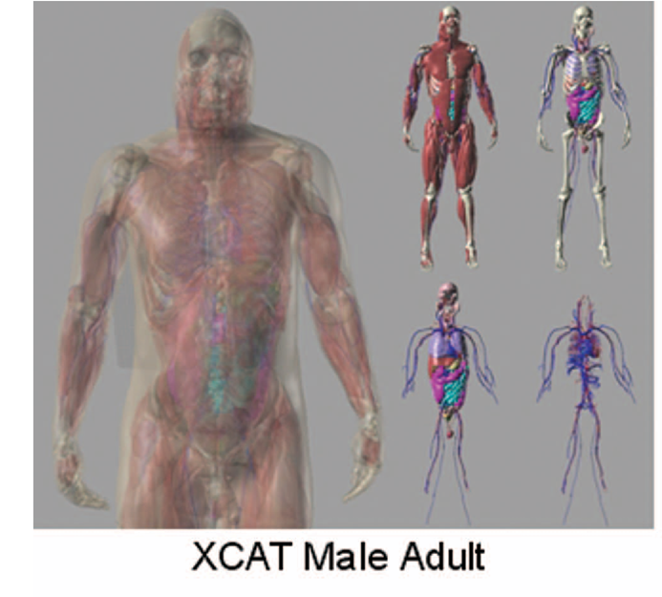
Initial Proposed Project
In-silico, track the flow of blood voxels through a whole-body phantom undergoing TBI, calculate their cumulative dose, and compare the dose to the voxels.
Whole Body Phantom (4D XCAT) model will unite a blood flow model and Monte Carlo Simulations to determine dose.
Notes:
Segars, William Paul, Jason Bond, John P. Frush, Sylvia Hon, Christopher P. Eckersley, Cameron H. Williams, Jianqiao Feng, Daniel Jacob Tward, J. Tilak Ratnanather, M. I. Miller, Donald P. Frush and Ehsan Samei. “Population of anatomically variable 4D XCAT adult phantoms for imaging research and optimization.” Medical physics 40 4 (2013): 043701 .

Slide 6

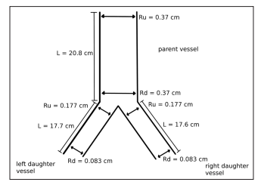
Progress to Date – Blood flow
Pulled the geometric information from the 4D XCAT phantom
Mapped the network
Created 1D-0D blood flow modelling code base
Used open-source VaMpy code base
Modified to use Structured Tree boundary conditions.
Confirmed methodology using a “toy example”
Notes:
Diem, Alexandra & Bressloff, Neil. “VaMpy: A Python Package to Solve 1D Blood Flow Problems.” Journal of Open Research Software. 5, 17, 2017.

Slide 7
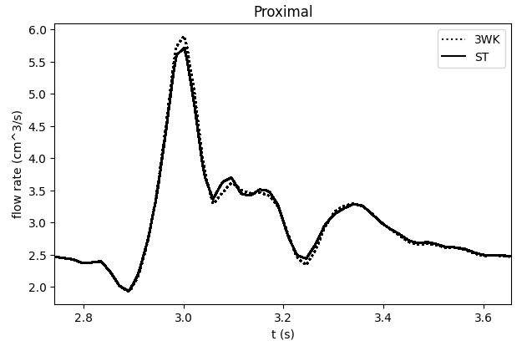
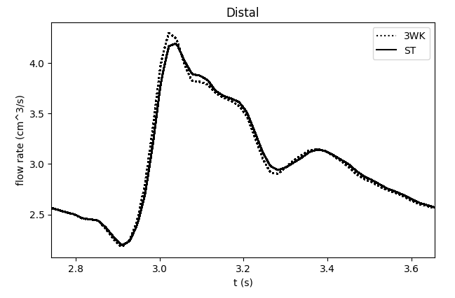
Max difference (absolute) = 0.2 cm^3/s
Notes:
Diem AK, Bressloff NW. VaMpy: A Python Package to Solve 1D Blood Flow Problems. Journal of Open Research Software. 2017;5(1). doi:10.5334/jors.159

Slide 8
“ One problem is however, that the rather complicated system of equations does not converge for all choices of parameters (the peripheral resistance, the top radius, and the bottom radius.”
– Dr. Mette Olufsen
0.006% of one period after months of work.
Notes:
Diem, Alexandra & Bressloff, Neil. “VaMpy: A Python Package to Solve 1D Blood Flow Problems.” Journal of Open Research Software. 5, 17, 2017.

Slide 9
Current Status – Blood Flow Modelling
Attempted to us established geometries for a limited number of systemic arteries. [1] Reached to 6%. Time to pivot again.
Notes:
[1] Cousins W, Gremaud PA. Impedance boundary conditions for general transient hemodynamics. International Journal for Numerical Methods in Biomedical Engineering. 2014;30(11):1294-1313. doi:10.1002/cnm.2658
[2] Alastruey, J., Parker, K. H., & Sherwin, S. J. (2012). Arterial pulse wave haemodynamics. In S. Anderson (Ed.), 11th International Conference on Pressure Surges (pp. 401-443). Virtual PiE Led t/a BHR Group.
[3]

Slide 10
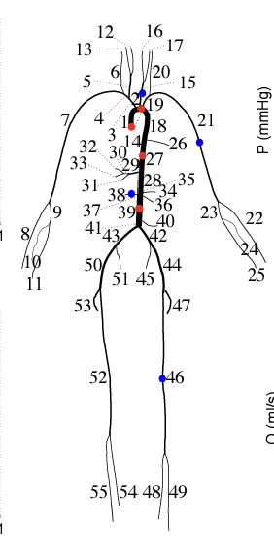
Current Status – Blood Flow Modelling
Attempted to us established geometries for a limited number of systemic arteries. [1] Reached to 6%. Time to pivot again.
Nektar 1D [2] is a Linux based or solving the nonlinear, one-dimensional (1-D) equations of blood flow in a network of compliant vessels subject to boundary and initial conditions.
We will use the existing 55-vessel model
Both Nektar use a “healthy young person” as the baseline and 4d xcat uses a 50th percentile adult.
Notes:
[1] Cousins W, Gremaud PA. Impedance boundary conditions for general transient hemodynamics. International Journal for Numerical Methods in Biomedical Engineering. 2014;30(11):1294-1313. doi:10.1002/cnm.2658
[2] Alastruey, J., Parker, K. H., & Sherwin, S. J. (2012). Arterial pulse wave haemodynamics. In S. Anderson (Ed.), 11th International Conference on Pressure Surges (pp. 401-443). Virtual PiE Led t/a BHR Group.
[3]

Slide 11
How do we address a one-way street?

Slide 12
Blood volumes will have the following properties within the simulation:
Location
Energy deposited (dose)
Time spent within the modelled arteries
At t < 0
Seed blood volumes, all starting at the aortic root
Random start times to prevent clustering
t >= 0 sec
Track the volumes through the known arteries
Assume 60 secs from aortic root to aortic root, “Round trip”. ~5 L blood volume and ~ 4-8 L/min cardiac output. TBD
Calculated dose / total time of exposure will be compared
Notes:
Source

Slide 13
Blood volumes will have the following properties within the simulation:
Location
Energy deposited (dose)
Time spent within the modelled arteries
At t < 0
Seed blood volumes, all starting at the aortic root
Random start times to prevent clustering
t >= 0 sec
Track the volumes through the known arteries
Assume 60 secs from aortic root to aortic root, “Round trip”. ~5 L blood volume and ~ 4-8 L/min cardiac output. TBD
Calculated dose / total time of exposure will be compared
Notes:
Source

Slide 14
Blood volumes will have the following properties within the simulation:
Location
Energy deposited (dose)
Time spent within the modelled arteries
At t < 0
Seed blood volumes, all starting at the aortic root
Random start times to prevent clustering
t >= 0 sec
Track the volumes through the known arteries
Assume 60 secs from aortic root to aortic root, “Round trip”. ~5 L blood volume and ~ 4-8 L/min cardiac output. TBD
Calculated dose / total time of exposure will be compared
Notes:
Source

Slide 15
Questions?

Slide 16
Current Status – Beam Modelling
With my work with Dr. Popescu preparing data for the CARO 2024 poster I’ve looking at modelling our sweeping Co-60.
Co-60 modelling is currently being updated from Levi Burns’ work [1].
Novel inquiries:
Does the cropping of patient CTs (chin to pelvis) affect the dose calculations significantly? Using the 4D XCAT phantom we can calculate cropped and uncropped dose to compare.
Yet to examine dose rate during Co-60 treatment.
Notes:
Burns L, Teke T, Popescu IA, Duzenli C. Monte Carlo Dosimetry of Organ Doses from a Sweeping-Beam Total Body Irradiation Technique: Feasibility and First Results. In: Lhotska L, Sukupova L, Lacković I, Ibbott GS, eds. World Congress on Medical Physics and Biomedical Engineering 2018. IFMBE Proceedings. Springer; 2019:421-427. doi:10.1007/978-981-10-9023-3_76

Slide 17
Questions?

Slide 18
Margins in TBI
Solid Tumour Treatment Planning
Total Body Irradiation Treatment Planning
CTV = Body Contour
CTV = Body Contour
PTV
CTV
TBI: The PTV extends outside of the patient’s body and we create a “flash” margin for Inverse Treatment Planning. Currently the margin is based on planner experience. After treatment planning the flash margin is removed and the dose is recalculated.
Flash margin: margin outside of the patient we fill with unit density material

Slide 19
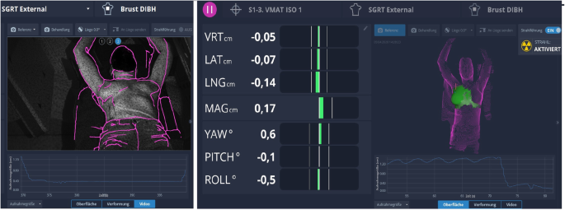
New Project – TBI Treatment Margins
BC Cancer – Vancouver has transitioned to VMAT TBI.
SGRT is used to aid in patient alignment.
This also provides with additional information on set-up error and patient motion during treatment at all isocenters
Notes:
Freislederer, P., Kügele, M., Öllers, M. et al. Recent advances in Surface Guided Radiation Therapy. Radiat Oncol 15, 187 (2020). https://doi.org/10.1186/s13014-020-01629-w

Slide 20
New Project – TBI Treatment Margins
Using this data we can calculate minimum treatment margins for TBI.
Using a Robustness study we can assess how well our current margins suit our needs using treatment plans from previously treated patients.
Goal: provide data informed TBI margins.

Slide 21
Questions?

